Slide 1
Compiler Flow using Mflowgen
Deepak Gopalan

Slide 2
Mflowgen Review - Basics
Modular flow specification and build-system generator for ASIC and FPGA design-space exploration built around sandboxed and modular steps.
Mflowgen allows you to programmatically define and parameterize a graph of steps (i.e., sandboxes that run anything you like) with well-defined inputs and outputs.
Build system files (e.g., make, ninja) are then generated which shuttle files between steps before running them.
Modularity – Reuse of steps
Sandboxed – Self contained steps, well defined inputs and outputs

Slide 3
Mflowgen Review – How to Set up
Define the graph – define the steps, add them to the graph and define connections between the steps. Can connect steps automatically by name or explicitly connect certain outputs of one step to certain inputs of another step. These have to be specified in a python script (construct.py)
Configure the Steps – specify the inputs, outputs and commands (how to go from inputs to outputs) Also can specify parameters, pre/post conditions for the step. Each step needs to have a directory which contains a configure.yml file where these details are entered
Build the design by invoking mflowgen and then run the steps

Slide 4
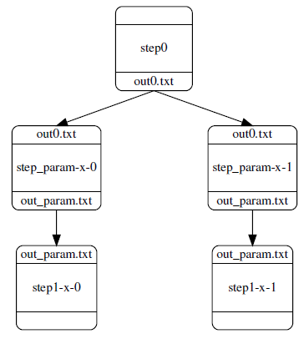
Mflowgen Review – Some cool Features
Parametrization – useful for exploring design spaces within a single graph
Parameter range is defined in the graph
Multiple copies of the parametrized step are created, each for one value of the parameter
Every step downstream the parameterized step also has different copies for each parameter value

Slide 5
Mflowgen Review – Some cool Features
Cloning – Instantiate the same step multiple times in one graph. The cloned steps are all similar, but they can be fed by different inputs
Assertions – Pre and Post conditions
File class: to check if a file is present
to check the occurrences of certain string in a file
Tool class: to check if a tool required for the step is set up
Can define custom pytest assertions
Can have multiline assertions which call some python helper functions
Stashing - share pre-built steps between people working on the same graph

Slide 6
Compiler Flow
Halide to Hardware
PE Generation
MetaMapper
Clockwork
RTL Simulation
DC Synthesis
Primetime PX

Slide 7
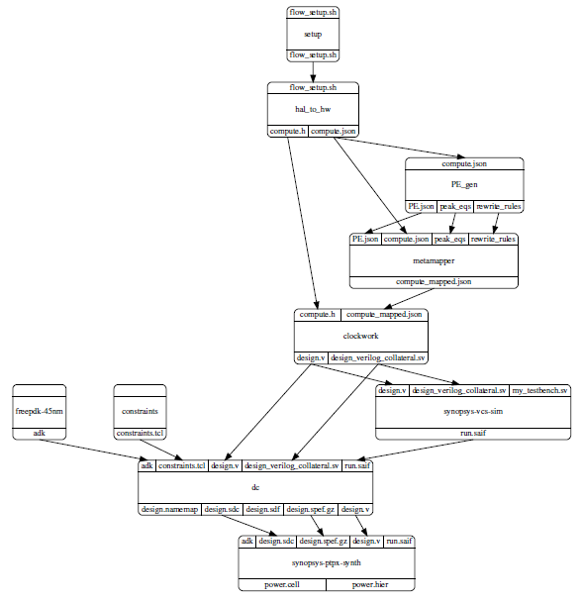
Mflowgen Chart

Slide 8
Halide to Hardware
The Input to this step is the application specified in Halide
Halide programs contain two parts: an algorithm and a schedule
The algorithm specifies the computation output, while the schedule specifies the scope of the accelerator, memory hierarchy, which loops to parallelize, Loop tiling etc.
The schedule allows the user to trade off locality, recomputation, and parallelism using different loop transformations

Slide 9
Halide to Hardware
The Halide program is then lowered to HalideIR
computational kernels represented by statements enclosed in for-loops
memory operations represented by reads and writes to multi-dimensional arrays.
Next, the compiler lowers the application to CoreIR graph
compute statements transformed into bitvector primitives (add, sub, mul)
loop nests transformed into streaming memories called unified buffers
Lowering the application from Halide to a CoreIR dataflow graph facilitates the subsequent mapping to hardware

Slide 10
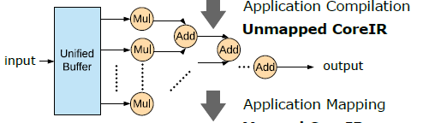
Halide to Hardware

Slide 11
PE Generation step
Takes application CoreIR as an input
Identifies candidate PE architectures by performing frequent subgraph analysis
1) Identify all the frequent subgraphs from the CoreIR
2) Find maximal independent set of each subgraph
(check non-overlapping subgraph frequency)
3) Merging subgraphs which share some operations

Slide 12
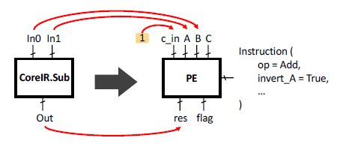
PE Generation step
The extent of merging can be tuned in order to move from multiple simple PEs to few but more complex PEs
Generates rewrite rules for mapping CoreIR operations to PE – uses an SMT Solver
Hardware generation – produces RTL Verilog for the PE
Functional model of PE in python

Slide 13
MetaMapper
This step maps the CoreIR compute nodes to the PE by using the rewrite rules from PE generation step to perform instruction selection
Gives the number of PEs used in the design, which can be used to tune PE Generation step

Slide 14
Clockwork
Takes MetaMapper’s output and performs memory mapping to map the abstract memories (unified buffers) with memory tiles
From the memory hardware specified in lake, high-level specifications such as capacity, number of ports, port widths, read/write delays are extracted
These specifications of hardware memory modules are used to produce a mapping of the application unified buffers to the hardware memory modules.
Hardware independent and Hardware dependent stages

Slide 15
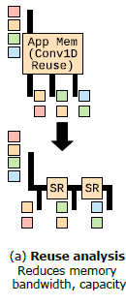
Clockwork – Hardware Independent Rewrite
Determine data-reuse using polyhedral analysis on the unified buffer’s access patterns
Same data fetched multiple times – use registers to reduce memory bandwidth
Obsolete data – overwrite it to reduce memory capacity

Slide 16
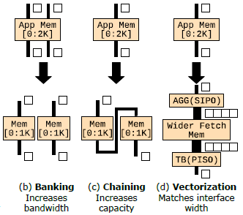
Clockwork – Hardware Dependent Rewrite
Transforms abstract memory to concrete hardware memory using extracted high-level hardware specifications
Banking to increase bandwidth
Chaining to increase capacity
Vectorization to match interface width

Slide 17
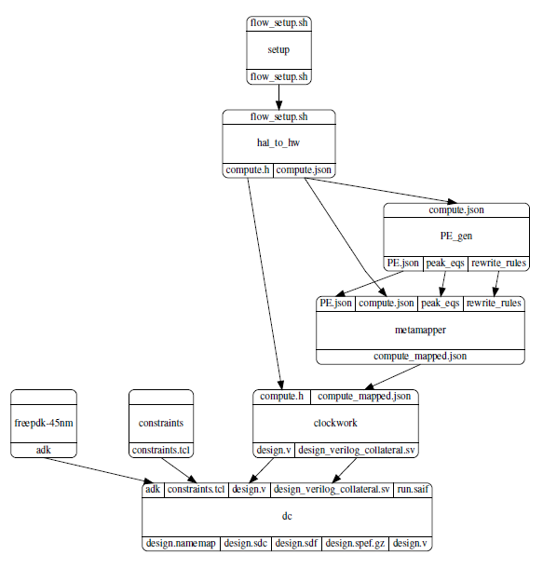
Experiments – Flowgraph

Slide 18
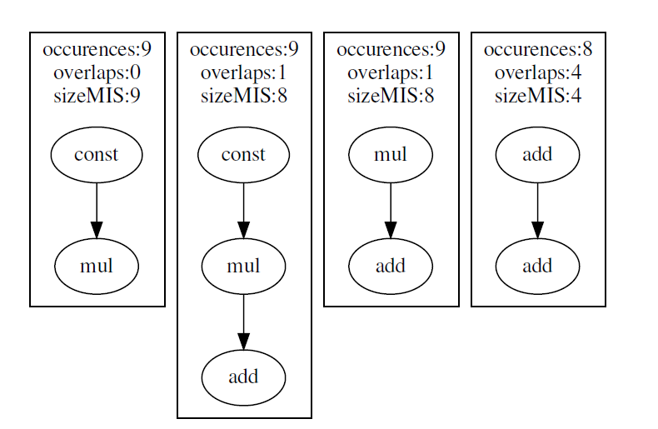
Experiments – Gaussian – Freq. subgraphs from CoreIR

Slide 19
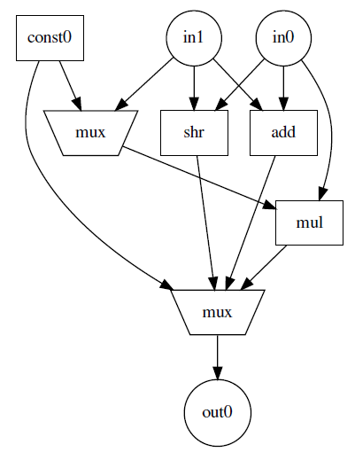
Experiments – Gaussian – Subgraph 0
in0 * const0
in0 * in1
in1 >> in0
const0
in1 + in0

Slide 20
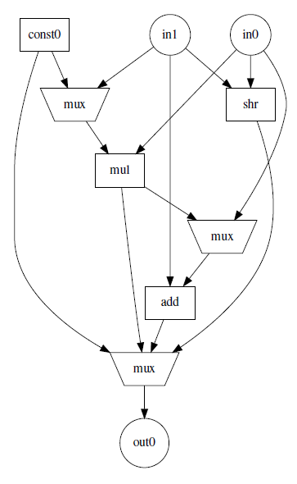
Experiments – Gaussian – Subgraph 1
(in0 * const0) + in1
in0 * in1
Const0
in1 >> in0
in0 + in1

Slide 21
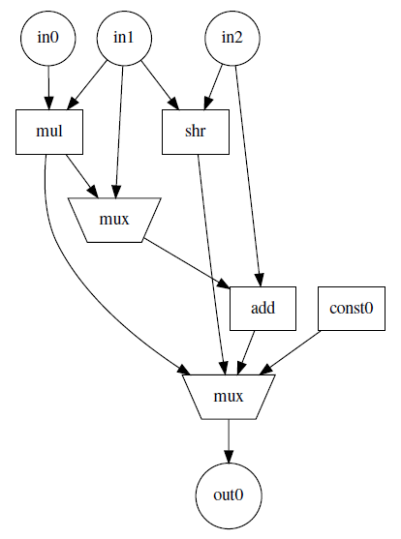
Experiments – Gaussian – Subgraph 2
(in0 * in1) + in2
in0 * in1
Const0
in2 >> in1
in1 + in2

Slide 22
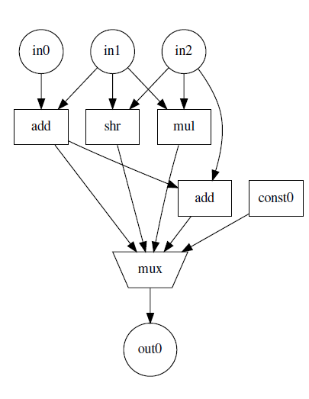
Experiments – Gaussian – Subgraph 3
in2 + (in0 + in1)
in2 * in1
Const0
in0 + in1
in2 >> in1

Slide 23
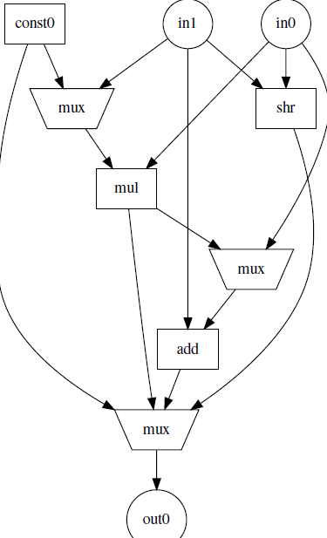
Experiments – Gaussian – Subgraph 0 + 1
(in0 * const0) + in1
in0 * const0
in0 * in1
Const0
in1 >> in0
in0 + in1

Slide 24
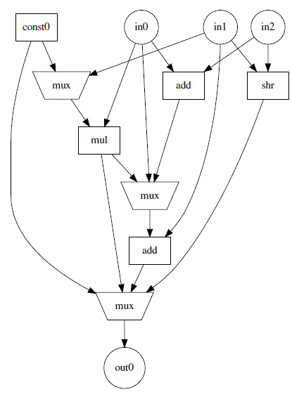
Experiments – Gaussian – Subgraph 1 + 3
(in0 * const0) + in1
(in0 + in2) + in1
in0 * in1
in2 >> in1
in0 + in1
const0

Slide 25
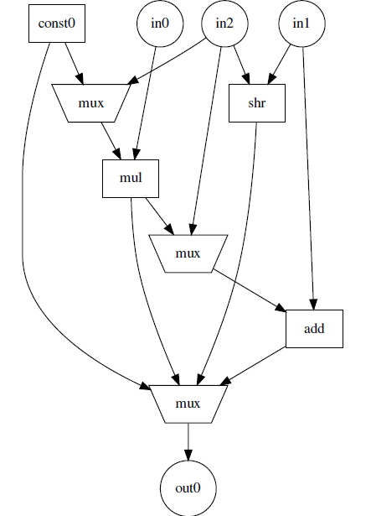
Experiments – Gaussian – Subgraph 0 + 1 + 2
(in0 * const0) + in1
in0 * const0
(in0 * in2) + in1
in0 * in2
in2 + in1
const0
in2 >> in1

Slide 26
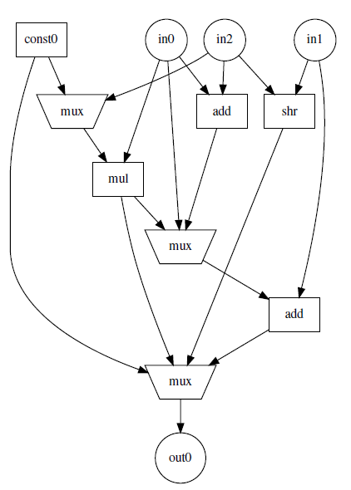
Experiments – Gaussian – Subgraph 0 + 1 + 2 + 3
(in0 * const0) + in1
in0 * const0
(in0 + in2) + in1
(in0 * in2) + in1
Const0
in0 + in1
in0 * in2
in2 >> in1

Slide 27
Gaussian - Number of PEs Used
Subgraph | Number of PEs
0 | 21
1 | 14
2 | 22
3 | 26
0 + 1 | 13
1 + 3 | 14
0 + 1 + 2 | 13
0 + 1 + 2 + 3 | 13

Slide 28
Gaussian – Area – old, wrong flattening
Subgraph | Comb | Buf | Non Comb | Total
0 | 7329 | 3514 | 44421 | 51751
1 | 8047 | 3924 | 44421 | 52469
2 | 8255 | 4000 | 44421 | 52677
3 | 8896 | 4545 | 44421 | 53318
0 + 1 | 6021 | 2297 | 44421 | 50443
1 + 3 | 7883 | 3803 | 44421 | 52304
0 + 1 + 2 | 7027 | 2893 | 44421 | 51448
0 + 1 + 2 + 3 | 7442 | 3285 | 44421 | 51864

Slide 29
Gaussian - Power (mW) – old, wrong flattening
Subgraph | Sw | Int | Leak | Total
0 | 1.8 | 24.4 | 1.0 | 27.1
1 | 2.3 | 25.2 | 1.0 | 28.5
2 | 2.5 | 25.3 | 1.0 | 28.9
3 | 2.2 | 25.1 | 1.1 | 28.4
0 + 1 | 1.58 | 24.0 | 0.9 | 26.5
1 + 3 | 2.3 | 25.0 | 1.0 | 28.3
0 + 1 + 2 | 2 | 24.3 | 1.0 | 27.3
0 + 1 + 2 + 3 | 2.1 | 24.5 | 1.0 | 27.6

Slide 30
Gaussian – Area - New
Subgraph | Comb | Buf | Non Comb | Total
0 | 29971 | 1637 | 44459 | 74430
1 | 20503 | 1054 | 44459 | 64962
2 | 31237 | 1483 | 44457 | 75694
3 | 37804 | 1924 | 44460 | 82264
0 + 1 | 19009 | 982 | 44459 | 63468
1 + 3 | 21725 | 1074 | 44421 | 66186
0 + 1 + 2 | 19073 | 973 | 44461 | 63534
0 + 1 + 2 + 3 | 20193 | 994 | 44461 | 64655

Slide 31
Gaussian - Power (mW) - New
Subgraph | Sw | Int | Leak | Total
0 | 4.2 | 25.2 | 1.5 | 31.0
1 | 2.0 | 23.6 | 1.3 | 26.9
2 | 1.8 | 23.6 | 1.5 | 26.9
3 | 3.3 | 24.7 | 1.6 | 29.6
0 + 1 | 2.0 | 23.6 | 1.2 | 26.8
1 + 3 | 1.8 | 23.4 | 1.3 | 26.5
0 + 1 + 2 | 1.7 | 23.4 | 1.2 | 26.3
0 + 1 + 2 + 3 | 1.7 | 23.4 | 1.3 | 26.4

Slide 32
Some stuff to add on
Use activity factors for power numbers – testbench for RTL simulation available for app mapped to lassen PE (uses random input data), which produces SAIF report to be passed onto DC and PTPX. Need to modify testbench generator for custom created PE.
Check other apps
Complete flow to Place and Route

